Slide 1
JAVASCRIPT GENERATORS
By Dmytro Minochkin

Slide 2
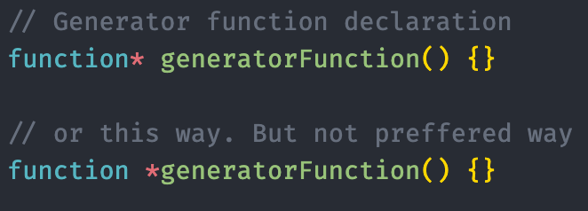
DEFINITION
A generator function is a function that returns a Generator object, and is defined by the function keyword followed by an asterisk (*)
You can place the asterisk next to the function name, but first variant is preferable

Slide 3
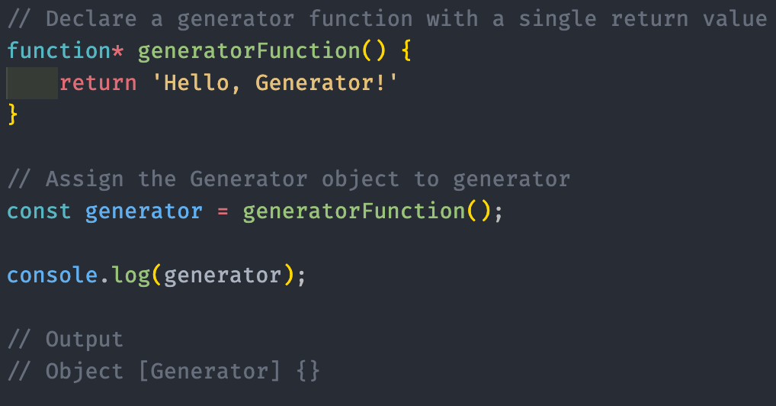
GENERATOR OBJECTS
Functions in JavaScript run to completion, and calling a function will return a value when it arrives at the return keyword.
If the return keyword is omitted, a function will implicitly return undefined.
A generator function does not return a value immediately, and instead returns an iterable Generator object.

Slide 4
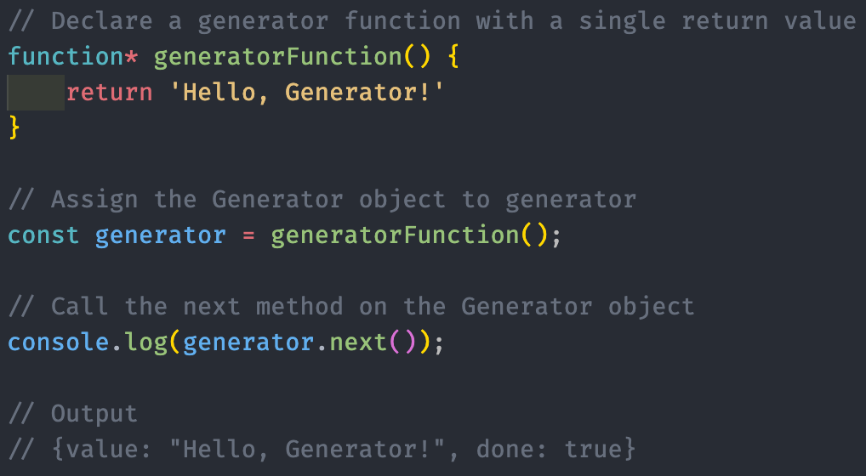
ITERATOR
The Generator object returned by the function is an iterator.
An iterator is an object that has a next() method available, which is used for iterating through a sequence of values.
The next() method returns an object with value and done properties.
value represent the returned value,
done indicates whether the iterator has run through all its values or not.

Slide 5
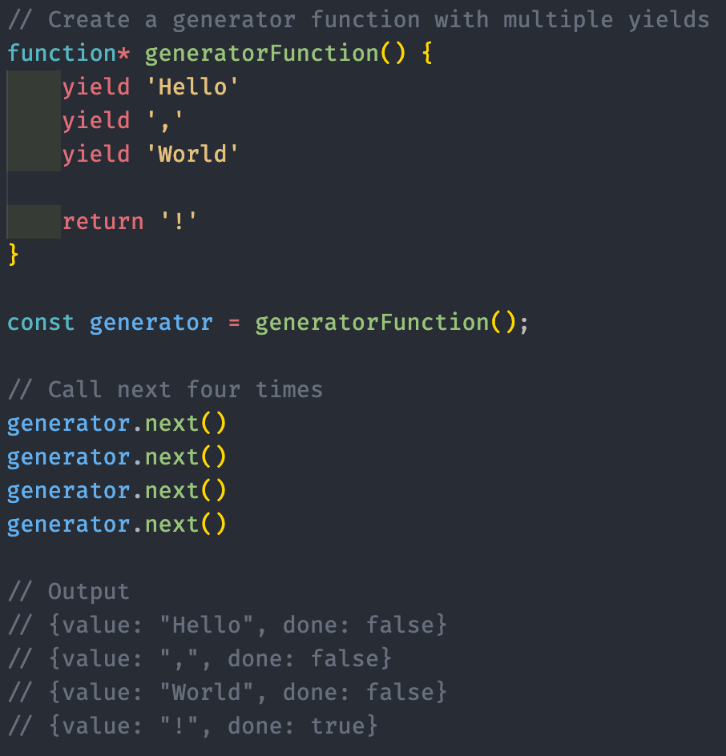
YIELD OPERATOR
Generators introduce a new keyword to JavaScript: yield.
yield can pause a generator function and return the value that follows yield
provides a lightweight way to iterate through values.

Slide 6
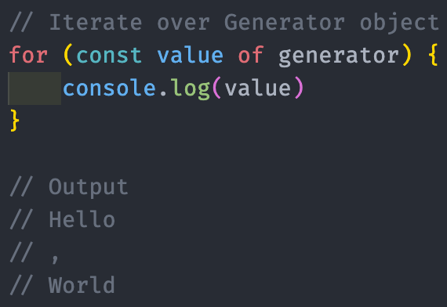
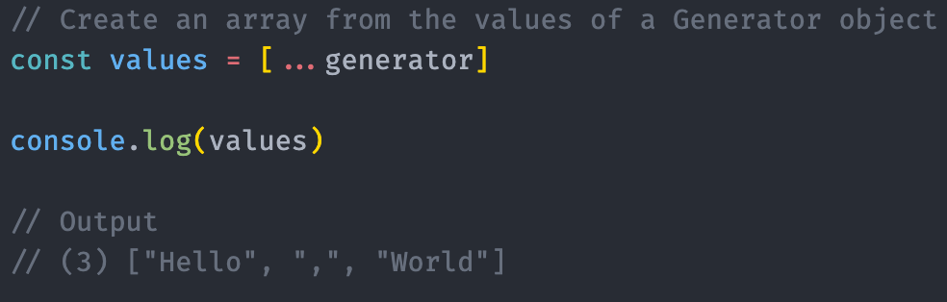
ITERATING OVER GENERATORS
Using the next() method, we manually iterated through the Generator object, receiving all the value and done properties of the full object.
In Javascript Arrays, Maps, Sets and Generators follows the iteration protocol, and can be iterated through with for...of
The spread operator can also be used to assign the values of a Generator to an array
Both spread and for...of will not factor the return into the values

Slide 7
GENERATOR OBJECT METHODS
Method | Description
next() | Returns the next value in a generator
return() | Returns a value in a generator and finishes the generator
throw() | Throws an error and finishes the generator

Slide 8
GENERATOR OBJECT STATES
Status | Description
suspended | Generator has halted execution but has not terminated
closed | Generator has terminated by either encountering an error, returning, or iterating through all values

Slide 9
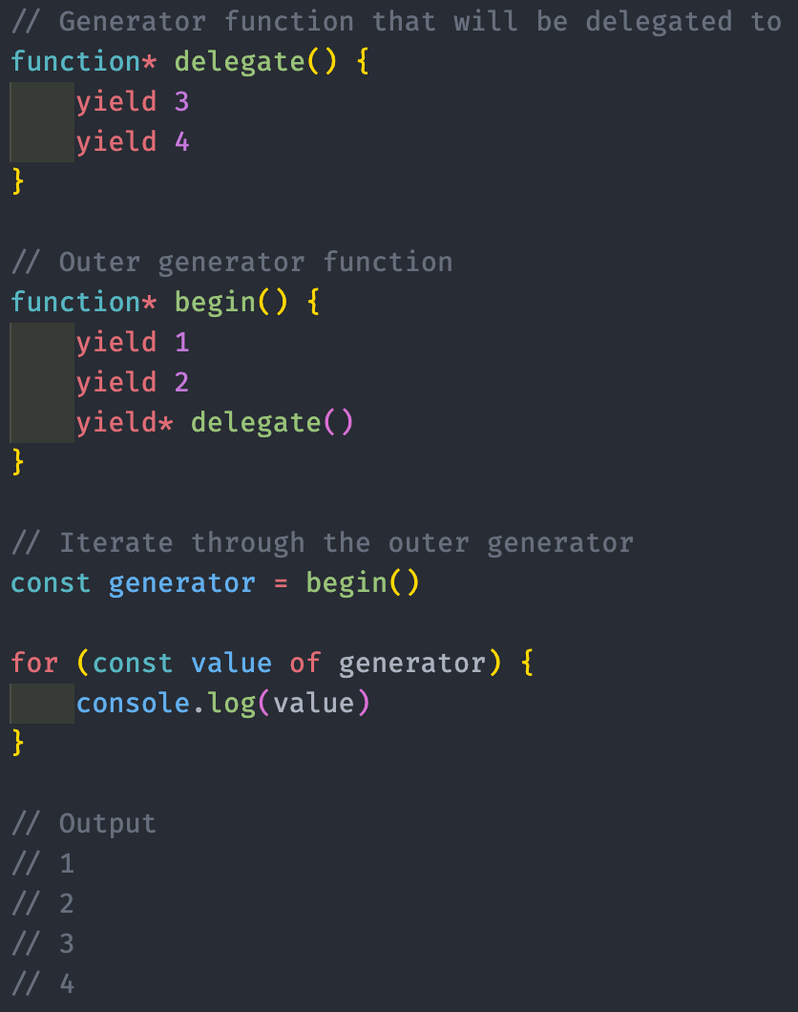
YIELD DELEGATION
Generators can also use the yield* expression to delegate further values to another generator.
When the yield* is encountered within a generator, it will go inside the delegated generator and begin iterating through all the yields until that generator is closed.

Slide 10
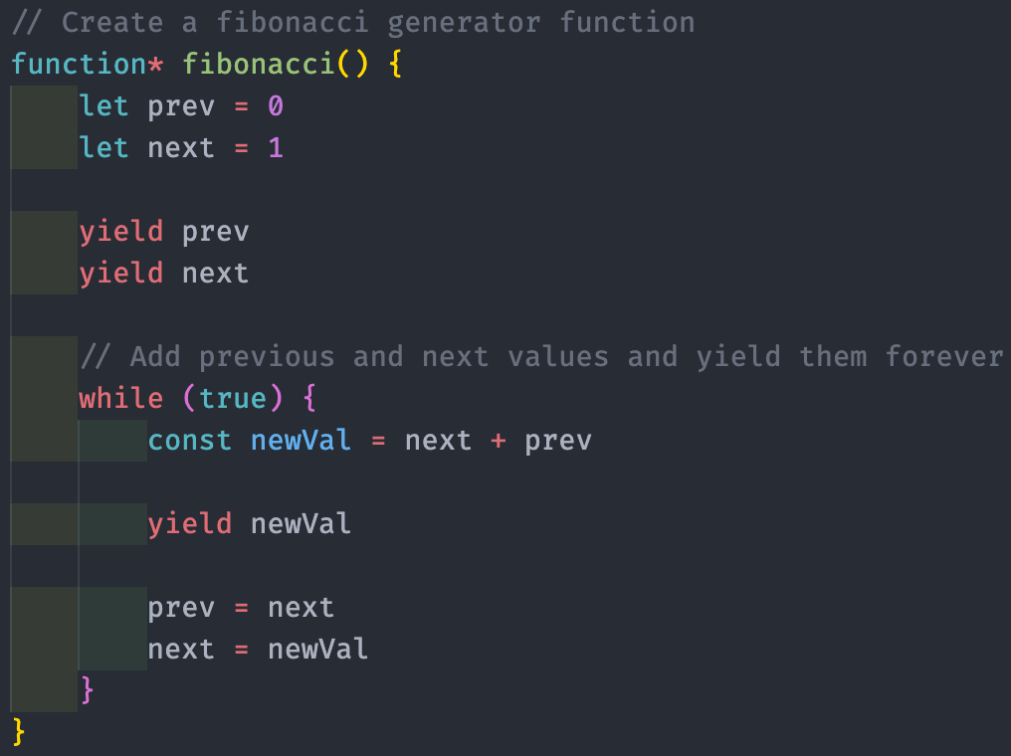
INFINITE DATA STREAMS I
One of the useful aspects of generators is the ability to work with infinite data streams and collections.
Can be done by creating an infinite loop inside a generator function.

Slide 11
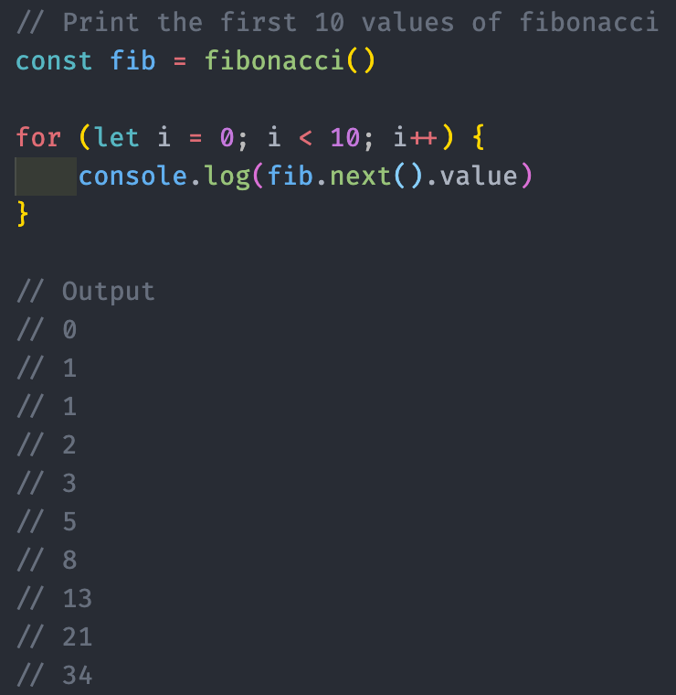
INFINITE DATA STREAMS I
One of the useful aspects of generators is the ability to work with infinite data streams and collections.
Can be done by creating an infinite loop inside a generator function.

Slide 12


